Slide 1
Object Identity & Reference Types in SQL

Slide 2
What is Object Identity?
Two things can have the same information, but still be different because they were created separately.
Example: Two employees named “John Smith” with the same job title and salary — but they are not the same person.
SQL Insight: Even if object data is identical, SQL treats each object as unique if created separately.

Slide 3
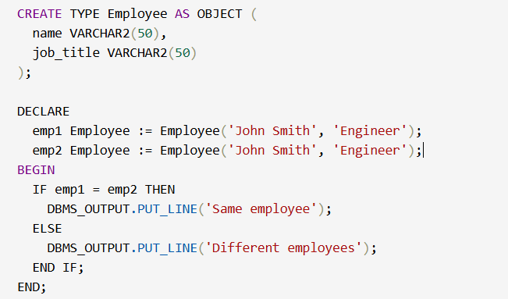
SQL Example – Object Identity
Even though both emp1 and emp2 have the same data, they’re different instances. Like two job applications from different people with the same name.

Slide 4
What are Reference Types?
A reference is a way to point to an object stored elsewhere in the database, instead of copying all its data again.
Real-World Example:
Imagine a company where:
Employee details are stored in one main table.
Offices store just a reference to the employee assigned to them.
Instead of storing name, job, and contact info everywhere, we store a pointer — like an Employee ID.
SQL Insight:
A REF points to an object in a table. You don’t duplicate the object — you just reference it.

Slide 5
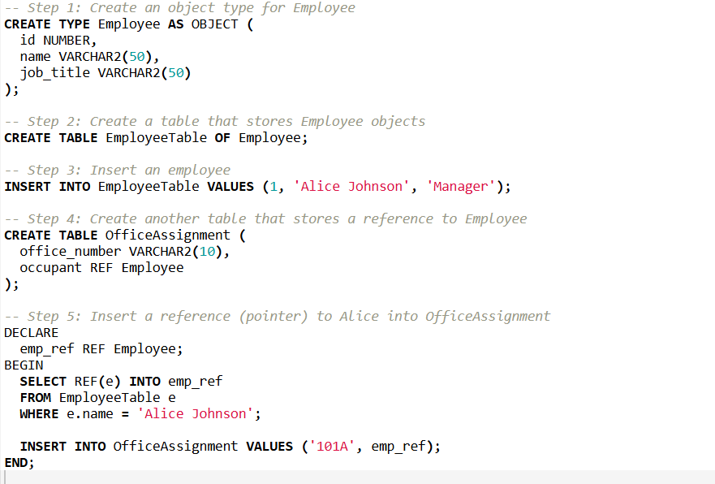
SQL Example – Reference Types

Slide 6
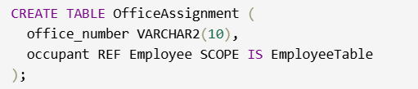

Types Of Reference Types
Scoped Reference
Tells SQL: “This reference will always point to objects in this specific table.”
Enforces safety and improves performance.
2. Unscoped Reference
More flexible, but less safe — it can point to any object of the correct type from any table.

Slide 7

Dereferencing
Dereferencing means Accessing the actual object that a REF (reference) points to.
It is used to access the data of the object that is referred
DEREF(occupant) returns the full object
You can then access attributes like .name or .job_title

Slide 8
THANK YOU

